Slide 1
Hobi Mockups
Easy view

Slide 2
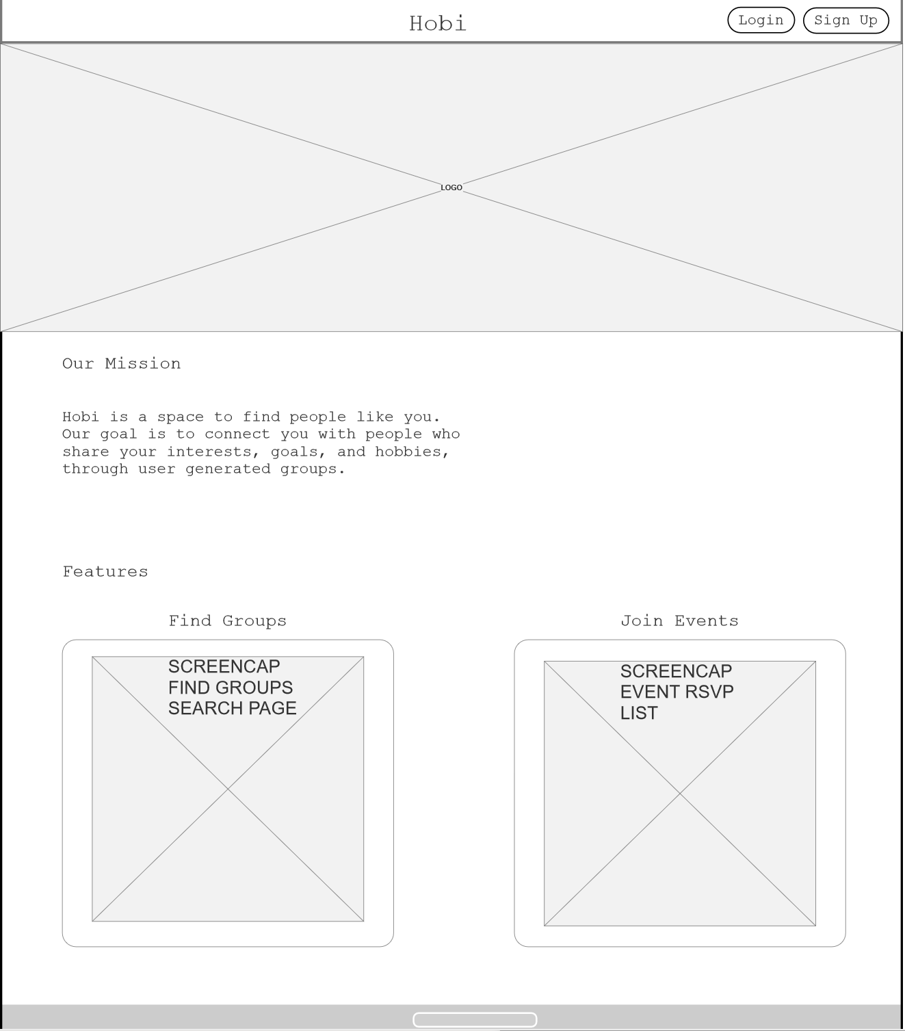
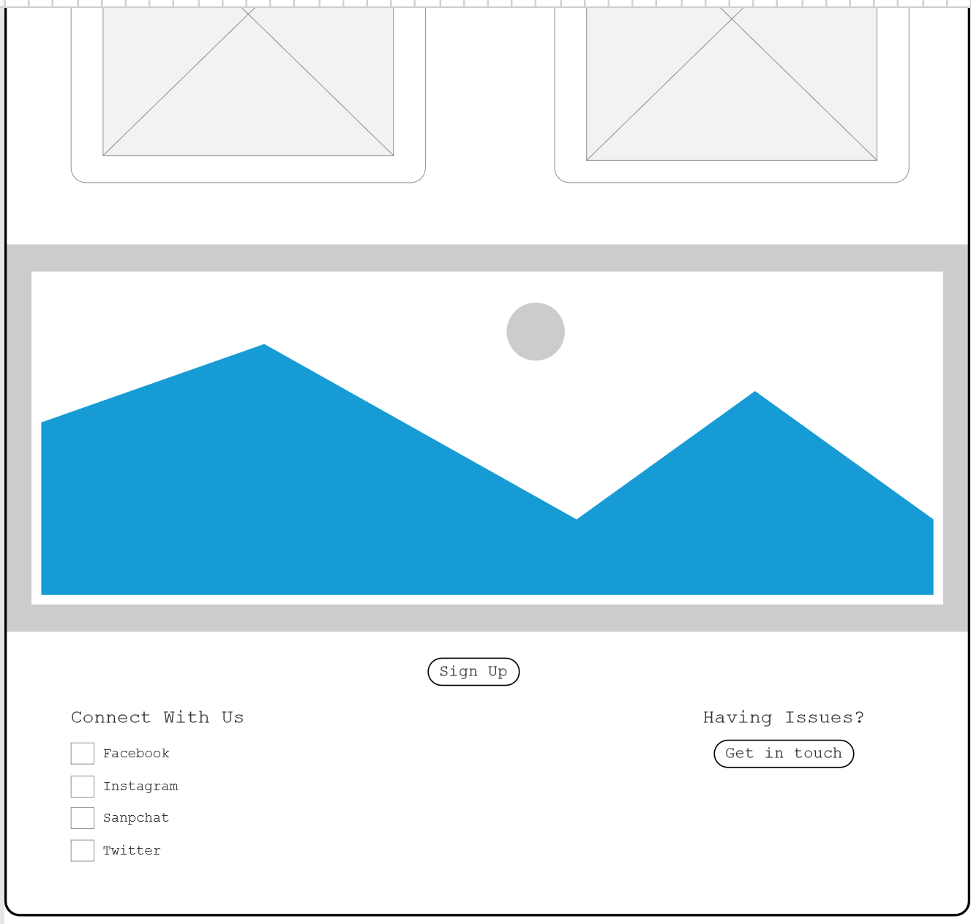
Landing Page

Slide 3
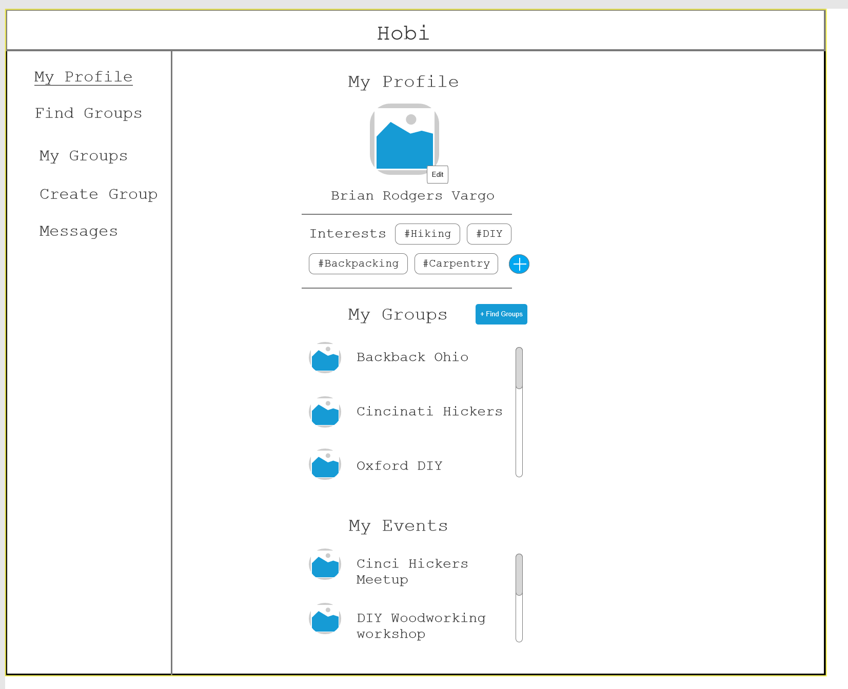
My Profile

Slide 4
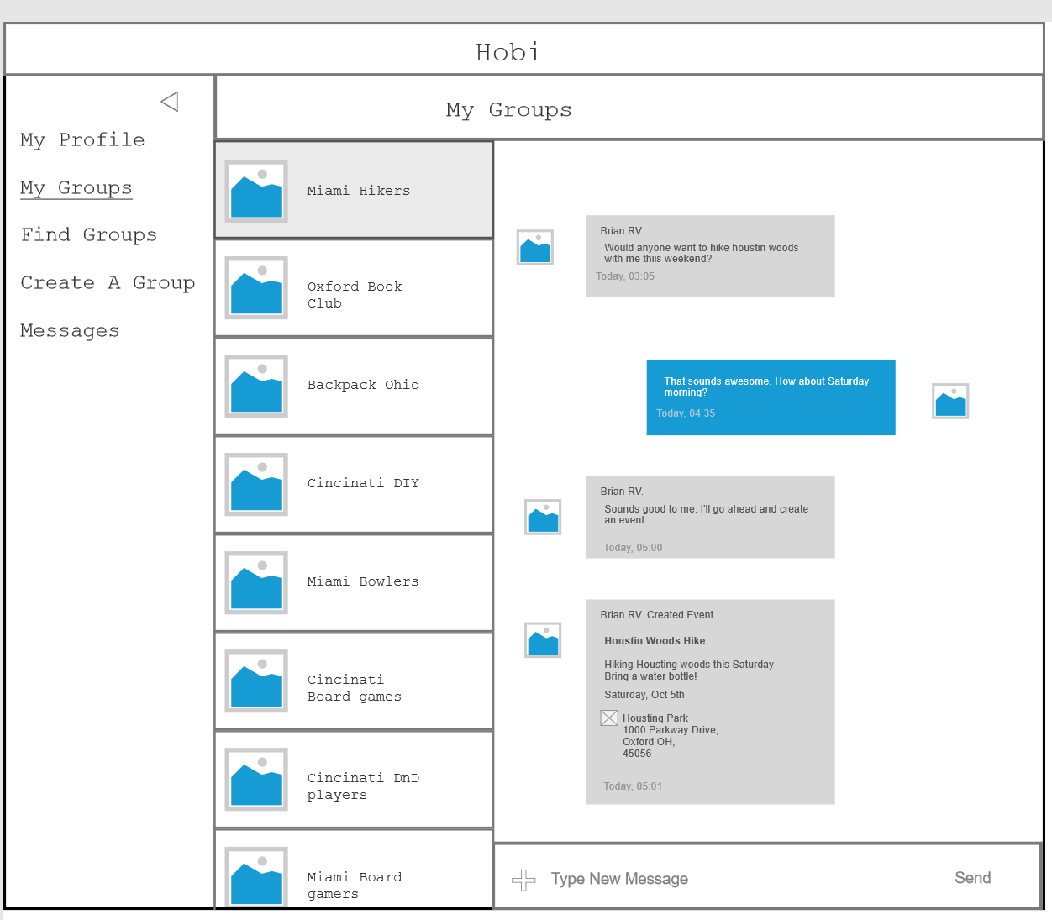
My Groups

Slide 5
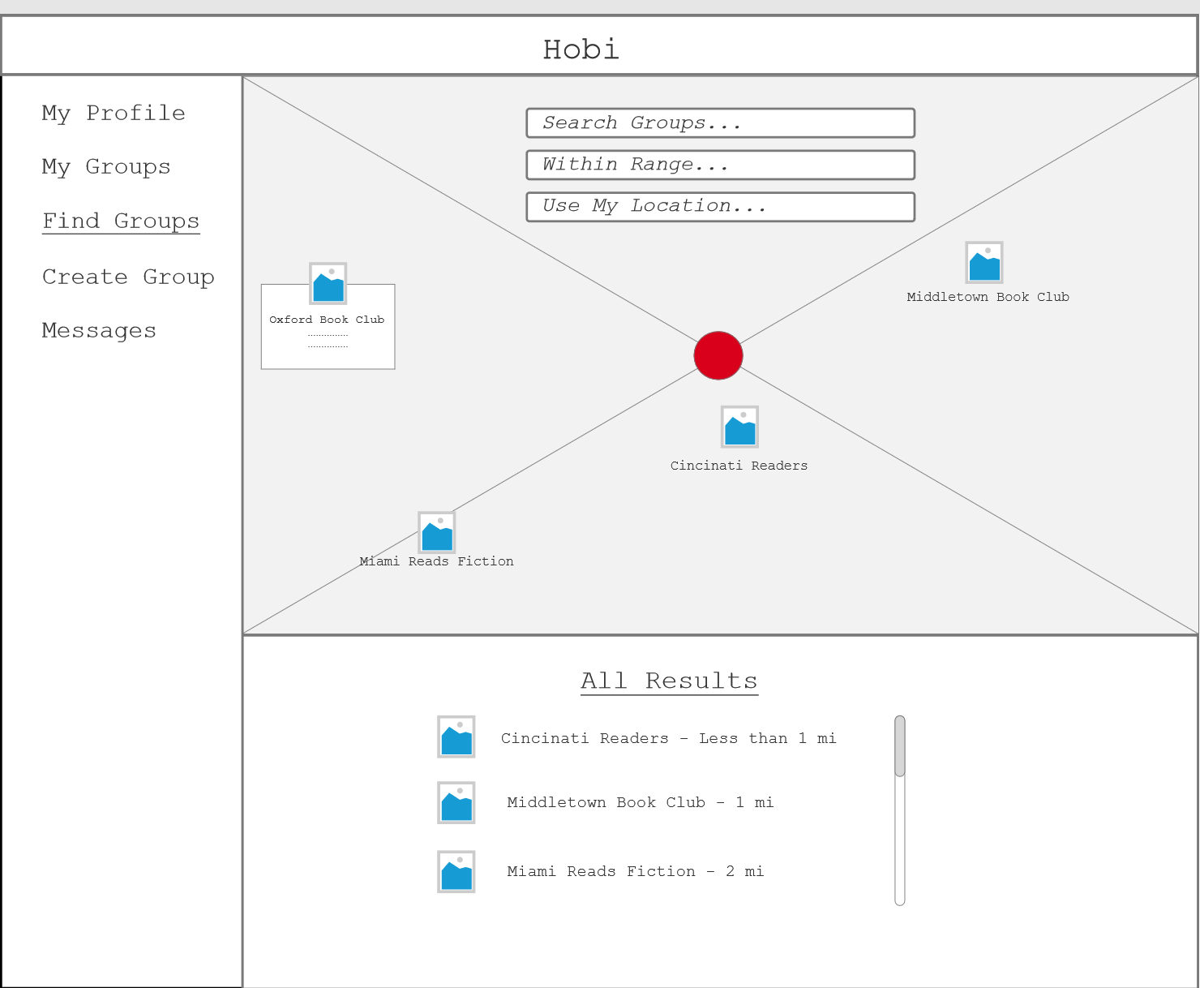
Find Groups

Slide 6
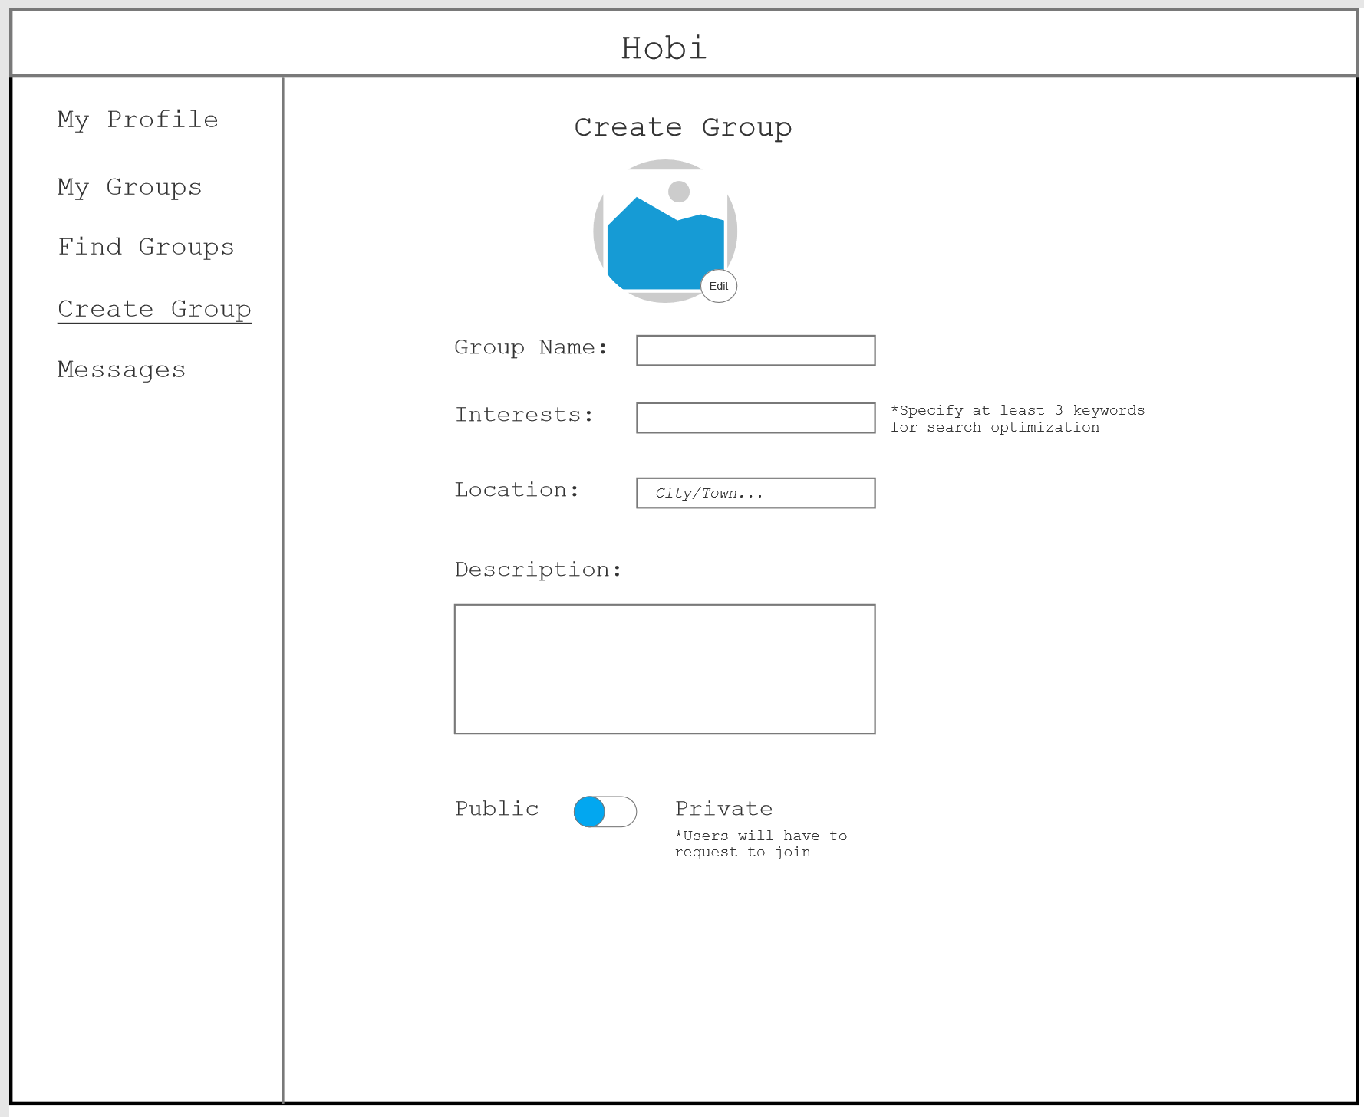
Create Group

Slide 7
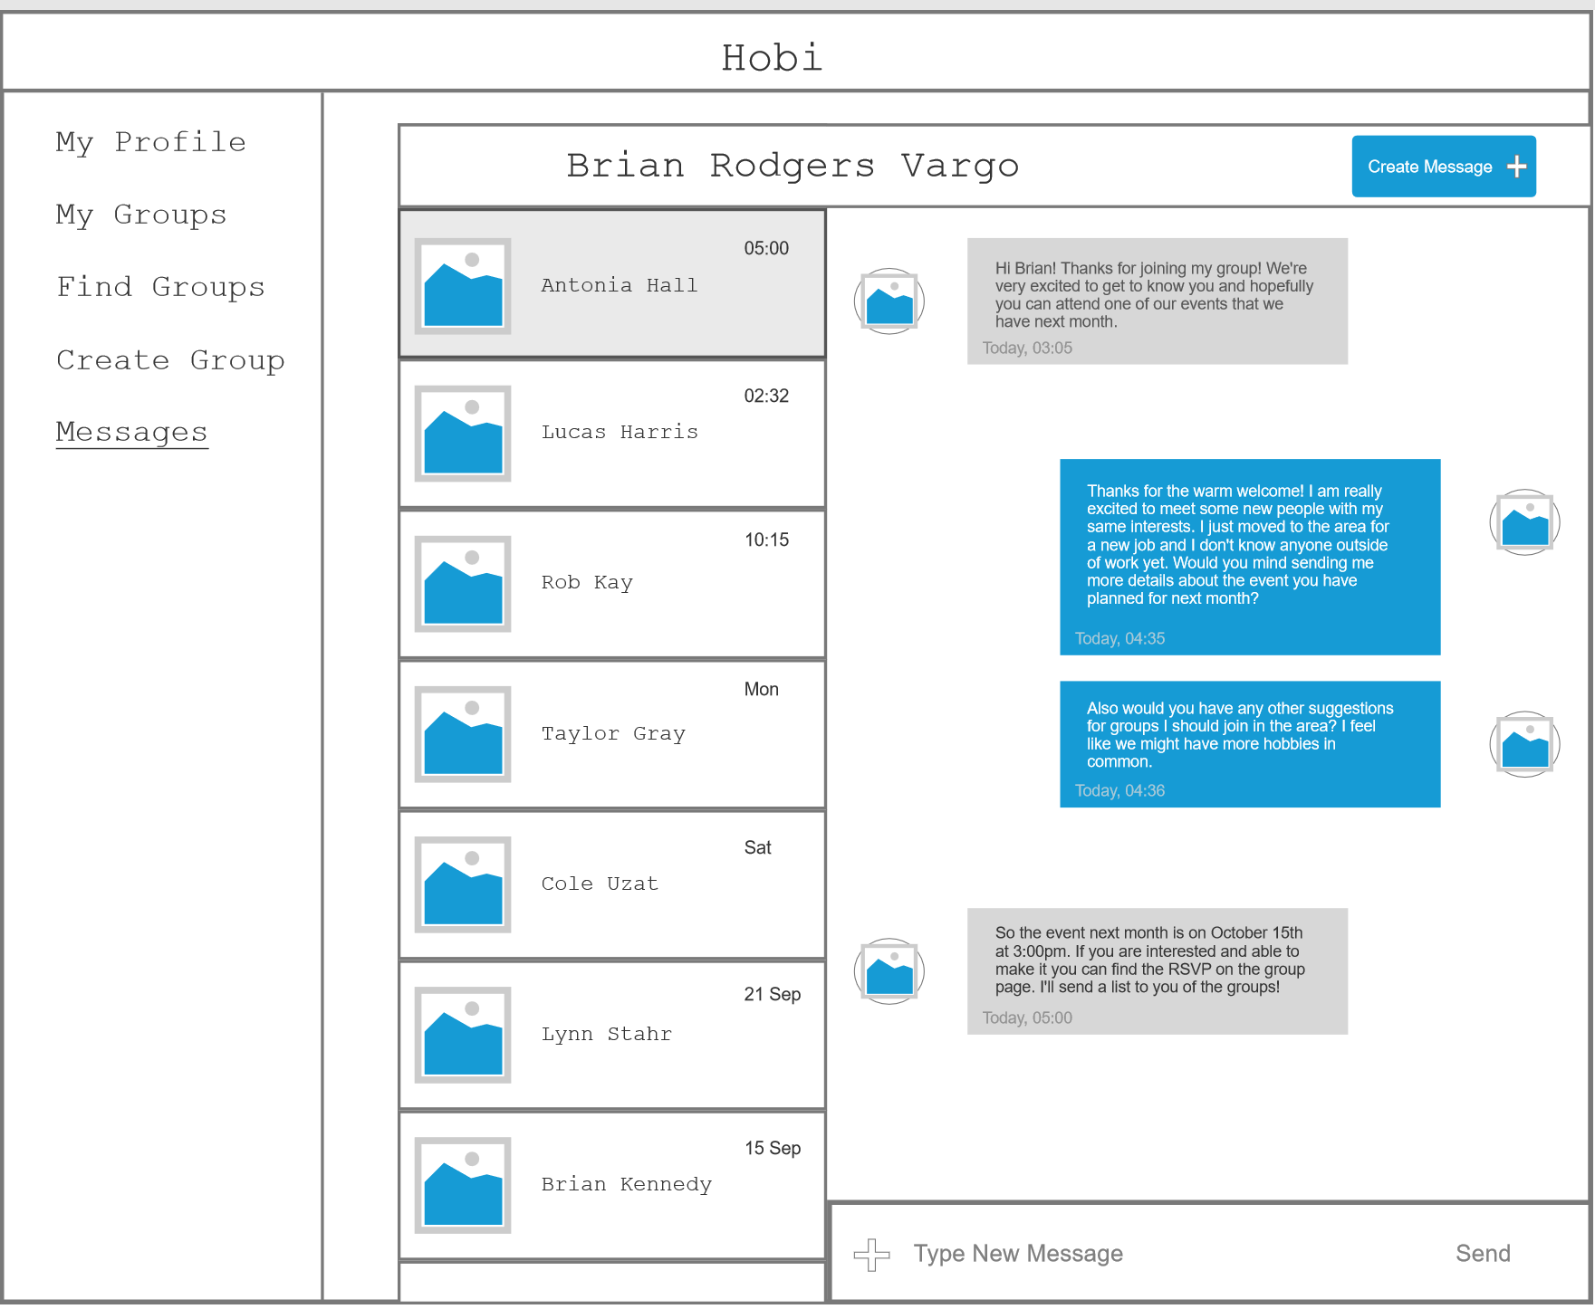
Messages

Slide 8
Still Needs…
Login Modal
Sign Up Modal
Create New Message Modal (Messages)
Create New Event Modal (My Groups)

